Slide 1
CSE 401
Game Playing
Alpha-Beta Search
and
General Issues

Slide 2
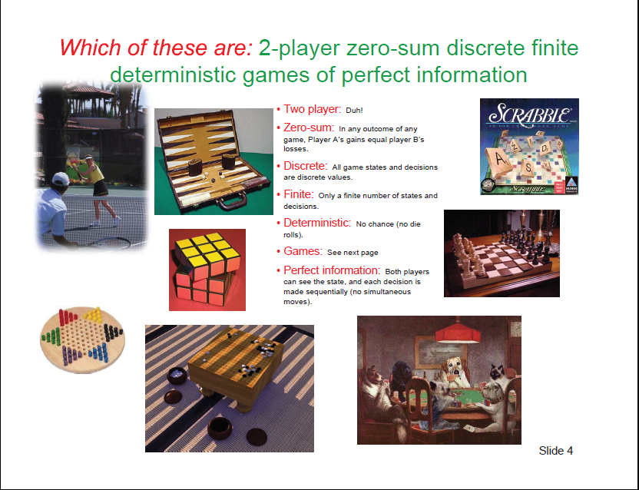

Slide 3
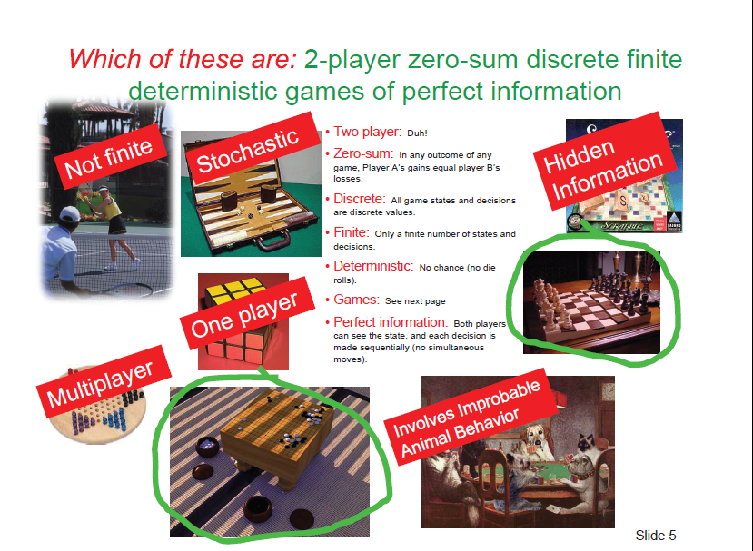

Slide 4
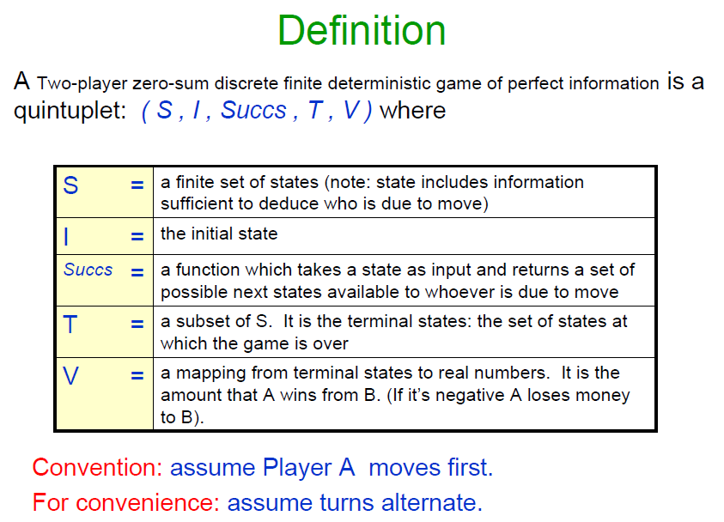

Slide 5
Utility Function
Gives the utility of a game state
  utility(State)
Examples
  -1, 0, and +1, for Player 1 loses, draw, Player 1 wins, respectively
  Difference between the point totals for the two players
  Weighted sum of factors (e.g. Chess)
    utility(S) = w₁f₁(S) + w₂f₂(S) + ... + w_{n}f_{n}(S)
      f₁(S) = (Number of white queens) – (Number of black queens), w₁ = 9
      f₂(S) = (Number of white rooks) – (Number of black rooks), w₂ = 5

Slide 6
Game Playing
Game tree
  describes the possible sequences of play
  is a graph if we merge together identical states
Minimax:
  utility values assigned to the leaves
Values “backed up” the tree by
  MAX node takes max value of children
  MIN node takes min value of children
  Can read off best lines of play
Depth Bounded Minimax
  utility of terminal states estimated using an “evaluation function”

Slide 7
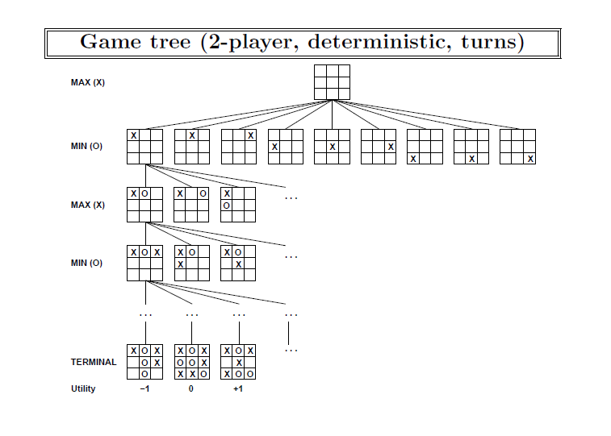
Game Tree for Tic-tac-toe

Slide 8
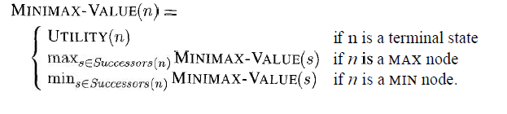
Minimax

Slide 9
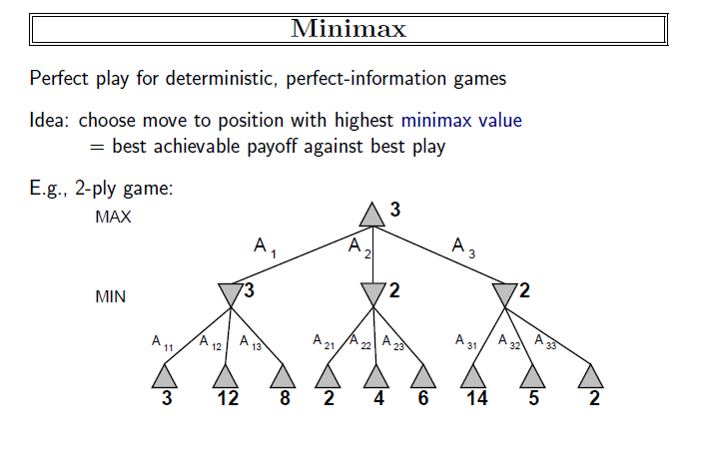
MiniMax

Slide 10
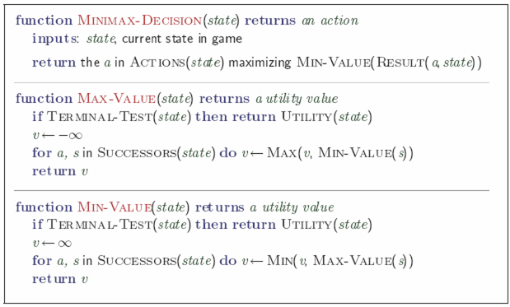
Basic Algorithm

Slide 11
MAX
1
A
MIN
1
B
-3
C
MAX
4
D
1
E
2
F
-3
G
4
-5
-5
1
-7
2
-3
-8
= terminal position
= agent
= opponent

Slide 12
Game Playing – Beyond Minimax
Efficiency of the search
  Game trees are very big
  Evaluation of positions is time-consuming
How can we reduce the number of nodes to be evaluated?
  “alpha-beta search”
Bounding the depth of minimax has deficiencies
  Why?
  How can we mitigate these deficiencies?

Slide 13
Game Playing – Improving Efficiency
Suppose that we are doing depth-bounded minimax
We have a game tree to create and then insert the minimax values in order to find the values for our possible moves from the current position

Slide 14
Game Playing – Minimax using DFS
The presentation of minimax was done by “backing up from the leaves” – a “bottom-up” breadth-first search.
This has the disadvantage of taking a lot of space
  Compare this with the space usage issues for DFS vs. BFS in earlier lectures
If we can do minimax using DFS then it is likely to take a lot less space
Minimax can be implemented using DFS
But reduced space is not the only advantage:

Slide 15
A
STOP! What else can
you deduce now!?
STOP! What else can
you deduce now!?
STOP! What else can
you deduce now!?
MAX
B
C
<=6
MIN
On discovering util( D ) = 6
we know that util( B ) <= 6
D
E
6
>=8
On discovering util( J ) = 8
we know that util( E ) >= 8
MAX
H
I
J
K
Can stop expansion of E as best play will not go via E
Value of K is irrelevant – prune it!
6
5
8
= agent
= opponent

Slide 16
Game Playing – Pruning nodes
If we are scanning the tree using DFS then there was no point in evaluating node K
Whatever the value of K there cannot be any rational sequence of play that would go through it
  Node K can be pruned from the search: i.e. just not selected for further expansion
“At node B then MIN will never select E; because J is better than D for MAX and so MIN must not allow MAX to have that opportunity”
Q. So what! It’s just one node?
A. Suppose that the depth limit were such that K was far from the depth bound. Then evaluating K corresponds to a large sub-tree. Such prunings can save an exponential amount of work

Slide 17
Game Playing – Improving Efficiency
Suppose that we were doing Breadth-First Search, would you still be able to prune nodes in this fashion?
NO! Because the pruning relied on the fact that we had already evaluated node D by evaluating the tree underneath D
This form of pruning is an example of “alpha-beta pruning” and relies on doing a DEPTH-FIRST search of the depth bounded tree

Slide 18
Game Playing – Node-ordering
Suppose that
  nodes K and J were evaluated in the opposite order
  can we expect that we would be able to do a similar pruning?
The answer depends on the value of K
Suppose that K had a value of 2 and is expanded first:

Slide 19
A
STOP! What else can
you deduce now!?
STOP! What else can
you deduce now!?
STOP! What else can
you deduce now!?
MAX
B
C
<=6
MIN
On discovering util( D ) = 6
we know that util( B ) <= 6
D
E
6
>=2
On discovering util( K ) = 2
we know that util( E ) >= 2
MAX
H
I
K
J
Can NOT stop expansion of E as best play might still go via E
Value of J is relevant – no pruning
6
5
2
8
= agent
= opponent

Slide 20
Game Playing – Node-ordering
When K had a value of 2 and was expanded first then we did not get to prune a child of E
To maximise pruning we want to first expand those children that are best for the parent
  cannot know which ones are really best
  use heuristics for the “best-first” ordering
If this is done well then alpha-beta search can effectively double the depth of search tree that is searchable in a given time
  Effectively reduces the branching factor in chess from about 30 to about 8
  This is an enormous improvement!

Slide 21
Game Playing – Improving Efficiency
The games are symmetric so is natural that we can also do a similar pruning with the MIN and MAX roles reversed
The reasoning is identical other than for the reversal of roles
Can deduce that some other nodes can not be involved in the line of best play

Slide 22
>=6
A
MAX
B
C
6
<=2
MIN
D
E
F
G
6
>=8
2
MAX
H
I
J
K
L
M
6
5
8
2
1
= agent
= opponent

Slide 23
Game Playing – Alpha-Beta Implementation
The pruning was based on using the results of the “DFS so far” to deduce upper and lower bounds on the values of nodes
Conventionally these bounds are stored in terms of two parameters
  alpha α
  beta β

Slide 24
Game Playing – Alpha-Beta Implementation
α values are stored with each MAX node
each MAX node is given a value of alpha that is the current best lower-bound on its final value
  initially is - ∞ to represent that nothing is known
  as we do the search then α at a node can increase, but it can never decrease – it always gets better for MAX

Slide 25
Game Playing – Alpha-Beta Implementation
β values are stored with each MIN node
each MIN node is given a value of beta that is the current best upper-bound on its final value
  initially is + ∞ to represent that nothing is known
  as we do the search then β at a node can decrease, but it can never increase – it always gets better for MIN

Slide 26
Alpha-beta Pruning
6
A
MAX
alpha pruning as β(C) < α(A)
β = 6
B
2
C
MIN
beta pruning as
α(E) > β(B)
D
E
F
2
G
6
α = 8
MAX
H
I
J
K
L
M
6
5
8
2
1
= agent
= opponent

Slide 27
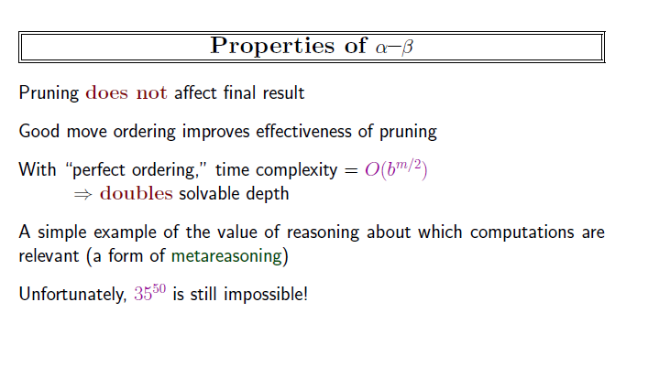

Slide 28
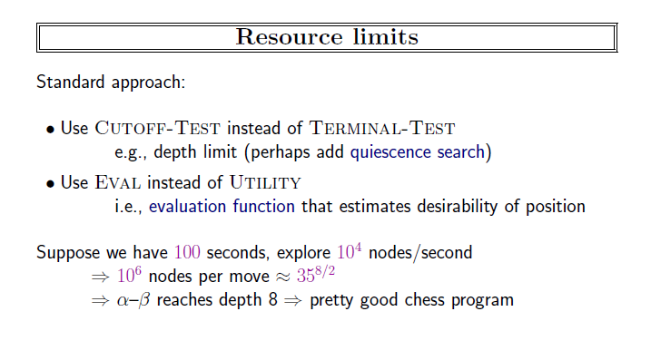

Slide 29
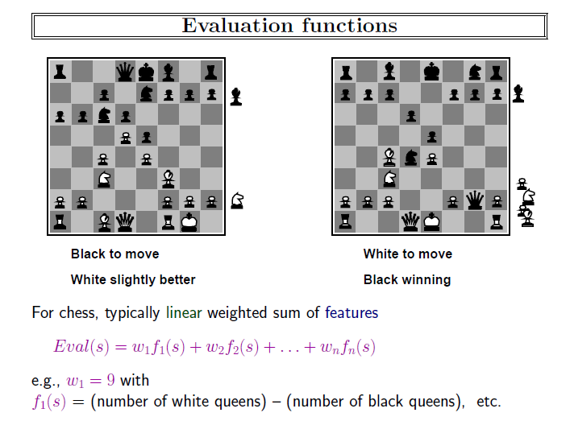

Slide 30
Game Playing – Deficiencies of Minimax
The bound on the depth of search is artificial and can lead to many anomalies.
We only consider two:
  Non-quiescence
  “quiescent” = inactive, quiet, calm, …
  Horizon Effect
(These deficiencies also apply to alpha-beta as it is just a more efficient way to do the same calculation as minimax)

Slide 31
Game Playing – Non-Quiescence
Suppose that change depth bound from k to k+1 – i.e. expand one more move
The values given to a node might change wildly

Slide 32
Example of non-quiescence
MAX
A
4 direct, but 1 by minimax
MIN
1
B
-3
C
B
Utility values of “terminal” positions obtained
by an evaluation function
Direct evaluation does not agree with one more
expansion and then using of minimax
= terminal position
= agent
= opponent

Slide 33
Game Playing – Quiescence Search
Suppose that change depth bound from k to k+1 – i.e. expand one more move
The values given to a node might change wildly
Keep on increasing the depth bound in that region of the game tree until the values become “quiescent” (“quiet”, i.e. stop being “noisy”)

Slide 34
Game Playing – Quiescence Search
In quiescence search the depth bound is not applied uniformly but adapted to the local situation
  in this case so that the values are not wildly changing
Many other improvements to minimax also work by adapting to depth-bound to get better results and/or do less work

Slide 35
Game Playing – Horizon Effect
Sometimes there is a bad thing, “X”, such that
  X cannot be avoided
  X can be delayed by some pointless moves
  X is not detected by the evaluation function
In this case depth-limited minimax can be fooled
It will use the pointless moves to push X beyond the depth limit, “horizon”, in which case it will “not see X”, and ignore it.
This can lead the search to take bad moves because it ignores the inevitability of X

Slide 36
Game Playing – Beyond alpha-beta
We looked briefly at two problems
  “non-quiescence”, and the “horizon effect”
and one solution “quiescence search”
To seriously implement a game
  Deep-blue, chinook, etc
it is necessary to solve many such problems!
Good programs implement many techniques and get them to work together effectively

Slide 37
Game Playing – Game Classification
So far have only considered games such as chess, checkers, and nim.
These games are:
Fully observable
  Both players have full and perfect information about the current state of the game
Deterministic
  There is no element of chance
  The outcome of making a sequence of moves is entirely determined by the sequence itself

Slide 38
Game Playing – Game Classification
Fully vs. Partially Observable
Some games are only partially observable
Players do not have access to the full “state of the game”
E.g. card games – you typically cannot see all of your opponents cards

Slide 39
Game Playing – Game Classification
Deterministic vs. Stochastic
In many games there is some element of chance
E.g. Backgammon – throw dice in order to move
(You are expected to be aware of these simple classifications)

Slide 40
Game Playing – Summary
Game Trees
Minimax
  utility values propagate back to the root
Bounded Depth Minimax
Alpha-Beta Search
  uses DFS
  with depth bound
  ordering of nodes is important in order to maximise pruning
Deficiencies of Bounded Depth Search
  Non-quiescence
    Combat using quiescence search
  Horizon Problem
    Combat with ?? (look it up!)

Slide 41
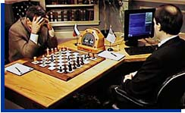
End of Game Playing
Garry Kasparov and Deep Blue. © 1997, GM Gabriel Schwartzman's Chess Camera, courtesy IBM.

